Slide 1
Sensory Physiology I
Introduction and Receptors
Prof Deepthi de Silva
Department of Physiology
Neuroscience module
D de Silva

Slide 2
At the end of this lecture, you should be able to
State the modalities (types) of sensation
State the types of sensory receptors in humans
State the meaning of ‘adequate stimulus’
Outline the mechanism of generating a receptor potential and state that they are graded
Outline how AP are discharged in afferent neurons
State how the location of a stimulus and its intensity are determined
Give examples of receptor adaptation
State the law of specific energies and projection
Outline the mechanism of lateral inhibition
Neuroscience module
D de Silva

Slide 3
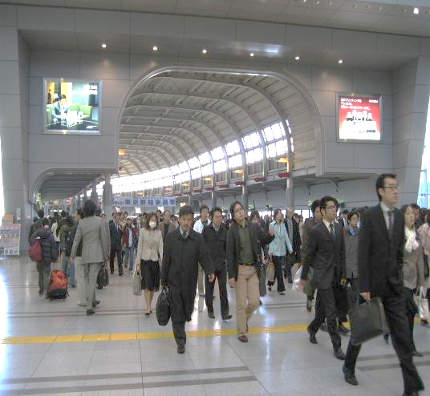
Sensory system
May 2009
Neuroscience module
D de Silva

Slide 4
Types (modalities) of Sensations
General sensory
Somatic
  Mechanical (touch/ pressure, position)
  Temperature (hot/ cold)
  Pain
Visceral
  Sensations from internal organs (H⁺, O₂ etc)
Special senses
Vision
Hearing & balance
Taste
Smell
Neuroscience module
D de Silva

Slide 5
Sensory Stimulus
Sensory receptor
Action potential in afferent neuron/s
Unconscious sensation/
reflex action
Spinal cord
Crude
Sensation/ memory
Brain-
Sub cortical
Conscious sensation/
Memory
Brain-
Cortex

Slide 6
Sensory Coding
Converting sensory information to a recognised sensation
Involves 4 aspects
Modality -what type of sensation is this?
Location – where is it coming from?
Intensity – how strong is this sensation?
Duration - how long does it last?
Neuroscience module
D de Silva

Slide 7
Modality of Sensation:
‘Adequate stimulus’
Receptors respond to one type of sensation [adequate stimulus] at low threshold
  e.g. Rods of retina respond to light
May respond to other stronger stimuli (at higher threshold)
  e.g. Stick a finger in your eye [touch] and you see stars [vision]
Neuroscience module
D de Silva

Slide 8
Modalities of sensations
Mechanical
Thermal
Electromagnetic
Chemical
Neuroscience module
D de Silva

Slide 9
Type of Sensory Receptors
Like transducers - Convert different types [modalities] of sensation to action potentials
Mechanoreceptors | Touch, pressure, (vibration)
Thermoreceptors | Hot & cold
Nociceptors | Pain
Chemoreceptors | Dissolved blood gases, taste, smell
Electromagnetic receptors | Light

Slide 10
Structure of Sensory Receptors
Free nerve ending
  (pain, temperature)
Specialised nerve endings
  e.g. Pacinian corpuscle (touch sensation)
Sense organ – eg taste bud
  sensory receptor in association with supportive cells
Neuroscience module
D de Silva

Slide 11
Mechanoreceptors
Activate combinations of receptors to detect a touch sensation
Meissner’s corpuscles
  Changes in texture and slow vibration
Merkel discs
  Sustained pressure & touch
Ruffini endings
  Sustained pressure
Pacinian corpuscle
  Deep pressure and fast vibration
Neuroscience module
D de Silva

Slide 12
Sensory Afferents
All are Aα or Aβ myelinated (fast conducting) fibres
Velocities of conduction high
  Aα 70- 120m/s
  Aβ 40-75 m/s
Neuroscience module
D de Silva

Slide 13
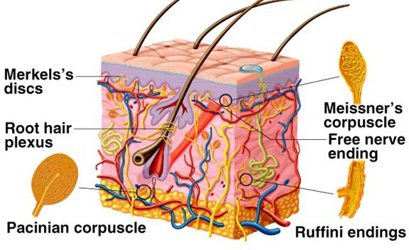
Neuroscience module
D de Silva

Slide 14
How do receptors work?
Opening of ion channels in the receptor membrane causes a receptor (generator) potential
How do these ion channels open?
  Mechanical deformation (e.g. Pacinian corpuscle)
  Chemical that binds to channels (e.g. taste receptor)
  Temperature change altering permeability
  Electromagnetic radiation that signals change in membrane potential (e.g. rod cells)
Neuroscience module
D de Silva

Slide 15
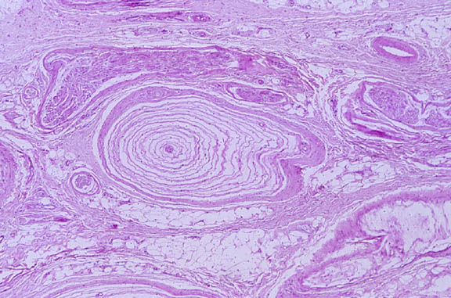
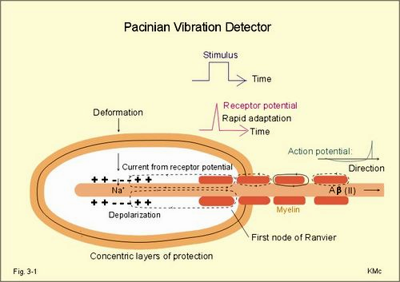
Mechanical pressure causes opening of Na+ channel
Graded potential generated
Deformation
Na+
1st node of Ranvier
May 2009
Neuroscience module
D de Silva

Slide 16
Adequate Stimulus
Opening of ion (mainly cation) channels
Depolarisation of receptor membrane
Depolarisation above threshold level >10mV
Depolarisation of 1st
Node of Ranvier
Action potential
in afferent fibre
Neuroscience module
D de Silva

Slide 17
Repolarisation of nerve
If there is a sustained generator potential
Another action potential is generated
* The generator potential is a graded potential
* All or none law applied to the action potentials
in the afferent nerve
Neuroscience module
D de Silva

Slide 18
Grading of Receptor potentials
Stimulus strength ∝ receptor potential
- stronger stimulus causes larger receptor potential
(graded potential)
Receptor potential ∝ Frequency of action potentials in afferent fibre
- larger receptor potential causes more frequent APs
Action potentials mV
Receptor potential mV
Threshold
Stimulus strength
Stimulus strength

Slide 19
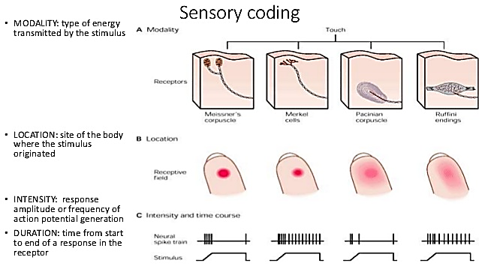
Touch
Meissner
Pacinian
Merkel
Ruffini
Neuroscience module
D de Silva

Slide 20
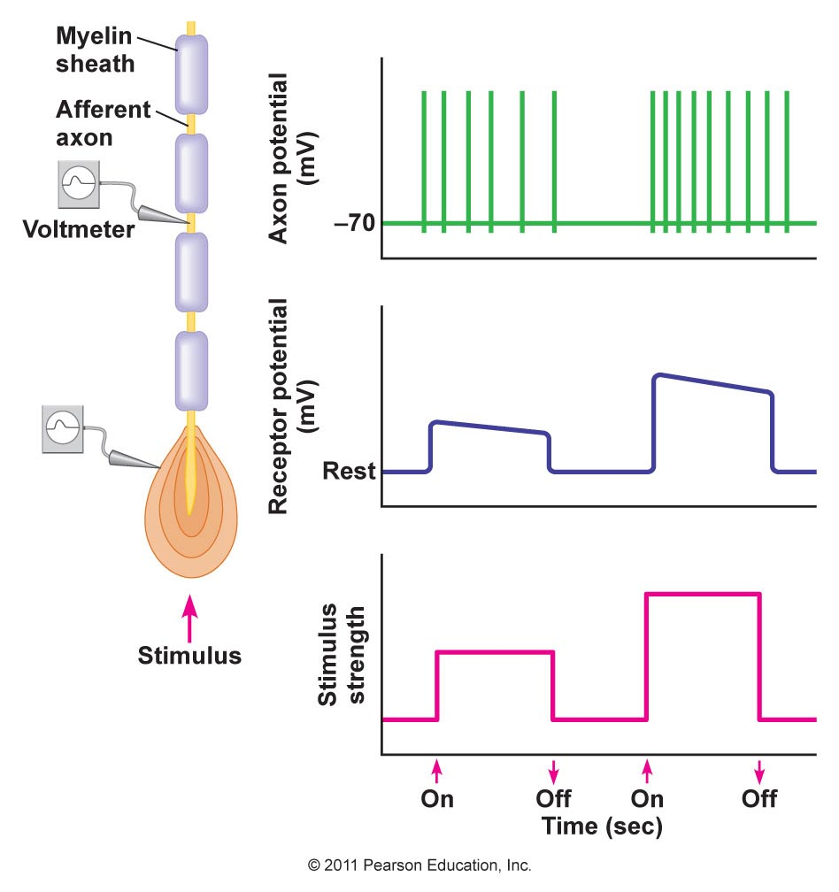
Neuroscience module
D de Silva

Slide 21
True or false regarding sensory receptors?
Mechanoreceptors respond to electromagnetic radiation
The Pacinian corpuscle is a specialised mechanoreceptor
The threshold of stimulation by the adequate stimulus is lower than by any other stimulus
The receptor potential rises with increasing intensity of stimulation
A subthreshold receptor potential at the 1st node of Ranvier is not transmitted
Neuroscience module
D de Silva

Slide 22
Determining location of stimulus
Specific pathway from receptor to specific brain area
  Neurons of this pathway only take the same modality of information
Stimulation at any point in this pathway causes the same sensation to be felt
  Doctrine of specific nerve energies
Stimulation of brain area for this pathway causes sensation to be felt at position of receptor
  Law of projection
Neuroscience module
D de Silva

Slide 23
Transmitting sensory information
Sensory unit - a sensory axon and all its branches
Receptive fields - area where stimulation causes response in a sensory unit
  finger tips have small fields while back has large fields
  Overlap of receptive fields occurs
Receptive field of neuron
May 2009
Neuroscience module
D de Silva

Slide 24
Maintaining accuracy of sensory transmission
    Inhibition
Two separate stimuli close to each other activate many sensory units
Lateral inhibition allows the two stimuli to be separated
Occurs in CNS
Direction of AP
-ve
-ve
Direction of AP
Neuroscience module
D de Silva

Slide 25
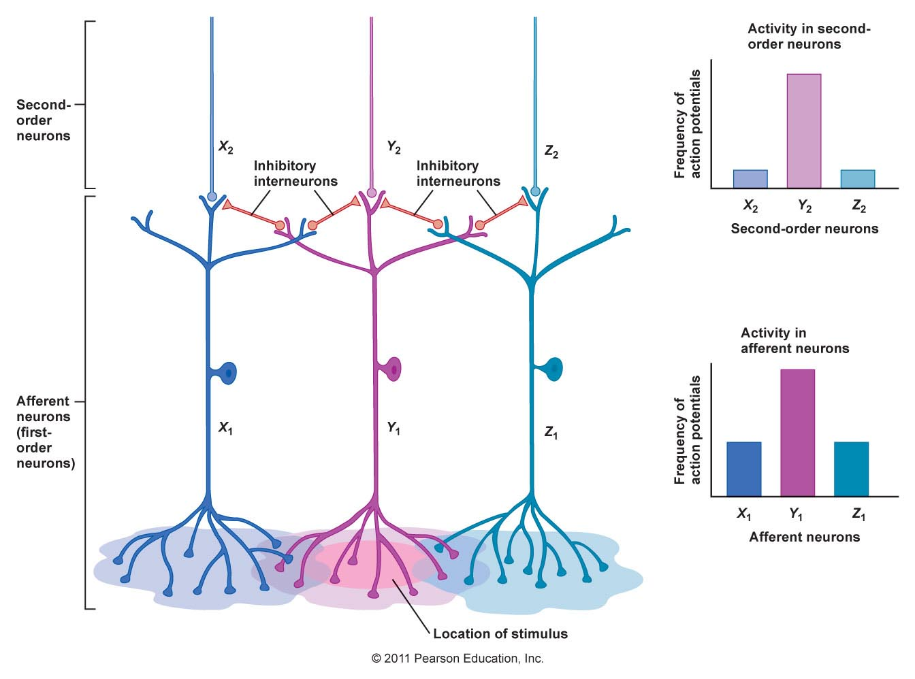
Increasing accuracy of locating single point of stimulation

Slide 26
Duration of a stimulus and the role of Adaptation
Decline in the frequency of APs with sustained receptor stimulation
Some receptors are
slow adapting (tonic) others adapt rapidly (phasic)
Impulses per sec
Time msec
Joint capsule receptors
Muscle spindle
Hair cell receptor
Pacinian corpuscle
Neuroscience module
D de Silva

Slide 27
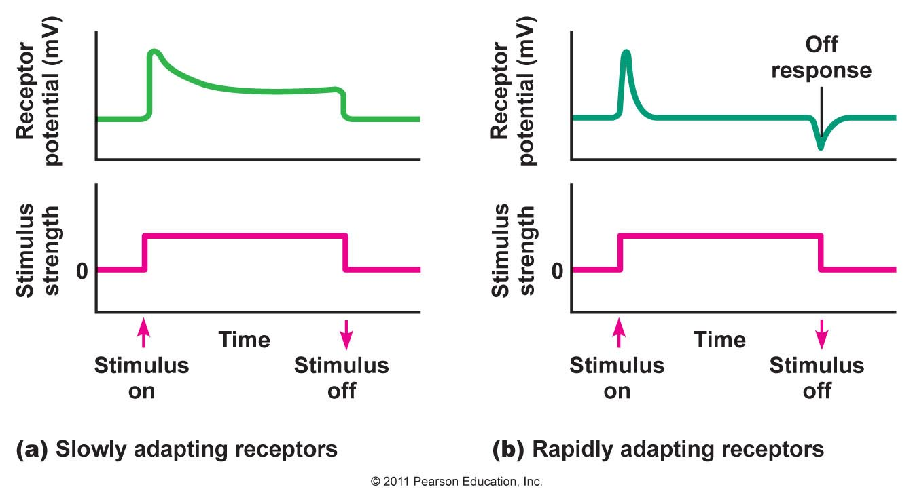
Tonic receptors
Phasic receptors
Neuroscience module
D de Silva

Slide 28
Determining stimulus intensity
The rate of discharge of action potentials
The number of stimulated sensory receptors
Neuroscience module
D de Silva

Slide 29
Coding for intensity of stimulus
Increasing stimulus
∞ Frequency of
action potentials
Action potential mV
Threshold
intensity
2. Increasing the
number of
activated
receptors
Increasing activation of
sensory receptors with
Increasing stimulus intensity
Neuroscience module
D de Silva

Slide 30
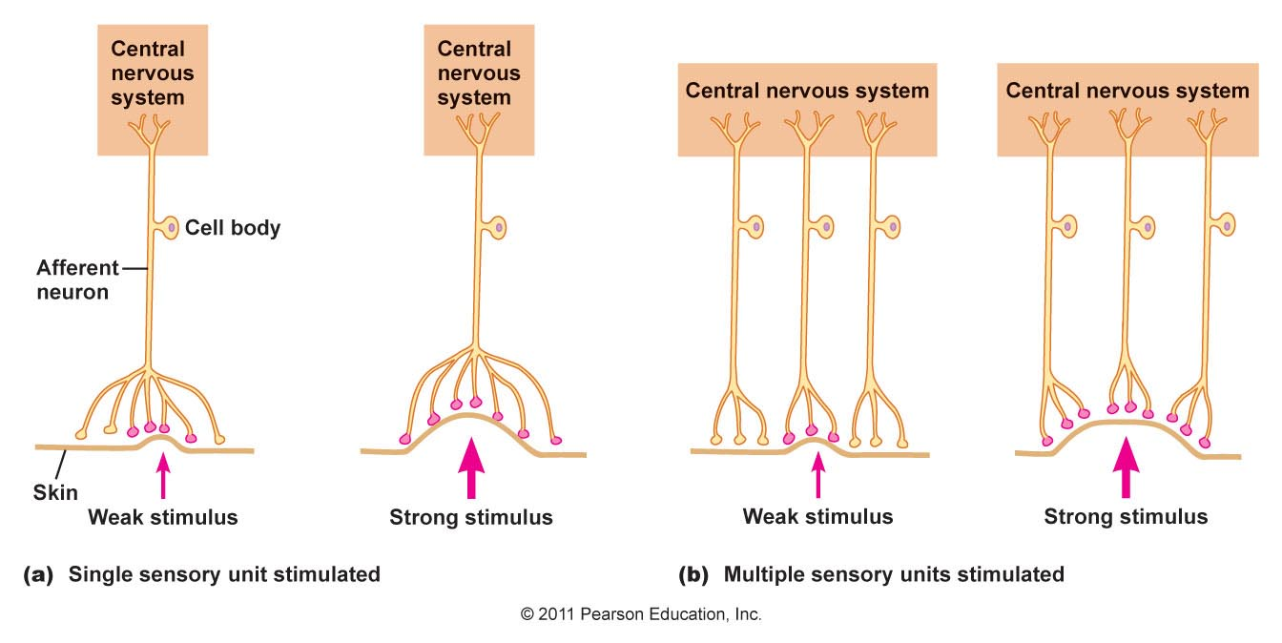
Determining the Intensity of a Stimulus
More sensory receptors stimulated
+/-
More afferent neurons (sensory units) stimulated

Slide 31
True or False?
The area of sensation of a sensory unit is called a receptive field
The finger tips have more overlapping receptor fields than the back
Lateral inhibition prevents localisation of sensory information
Stimulation of a pathway for a sensation always causes the same sensation to be felt
The law of projection states that stimulation of the primary sensory cortex causes a stimulus to be localised at a specific location
Neuroscience module
D de Silva

Slide 32
State the difference between a phasic and tonic receptor giving an example of each
State what determines the modality of sensation
State two mechanisms used to determine the intensity of stimuli
Neuroscience module
D de Silva

Slide 33
Can you
State the modalities (types) of sensation
State the types of sensory receptors in humans
State the meaning of ‘adequate stimulus’
Give examples of receptor adaptation
Outline the mechanism of generating a receptor potential and state that they are graded
Outline how AP are discharged in afferent neurons
State the law of specific energies and projection
State how the location of a stimulus and its intensity are determined
Outline the mechanism of lateral inhibition
Neuroscience module
D de Silva

